Slide 1
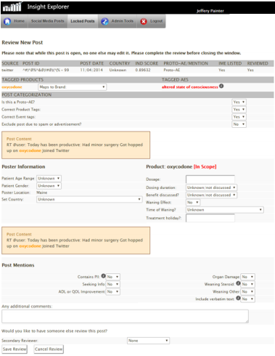
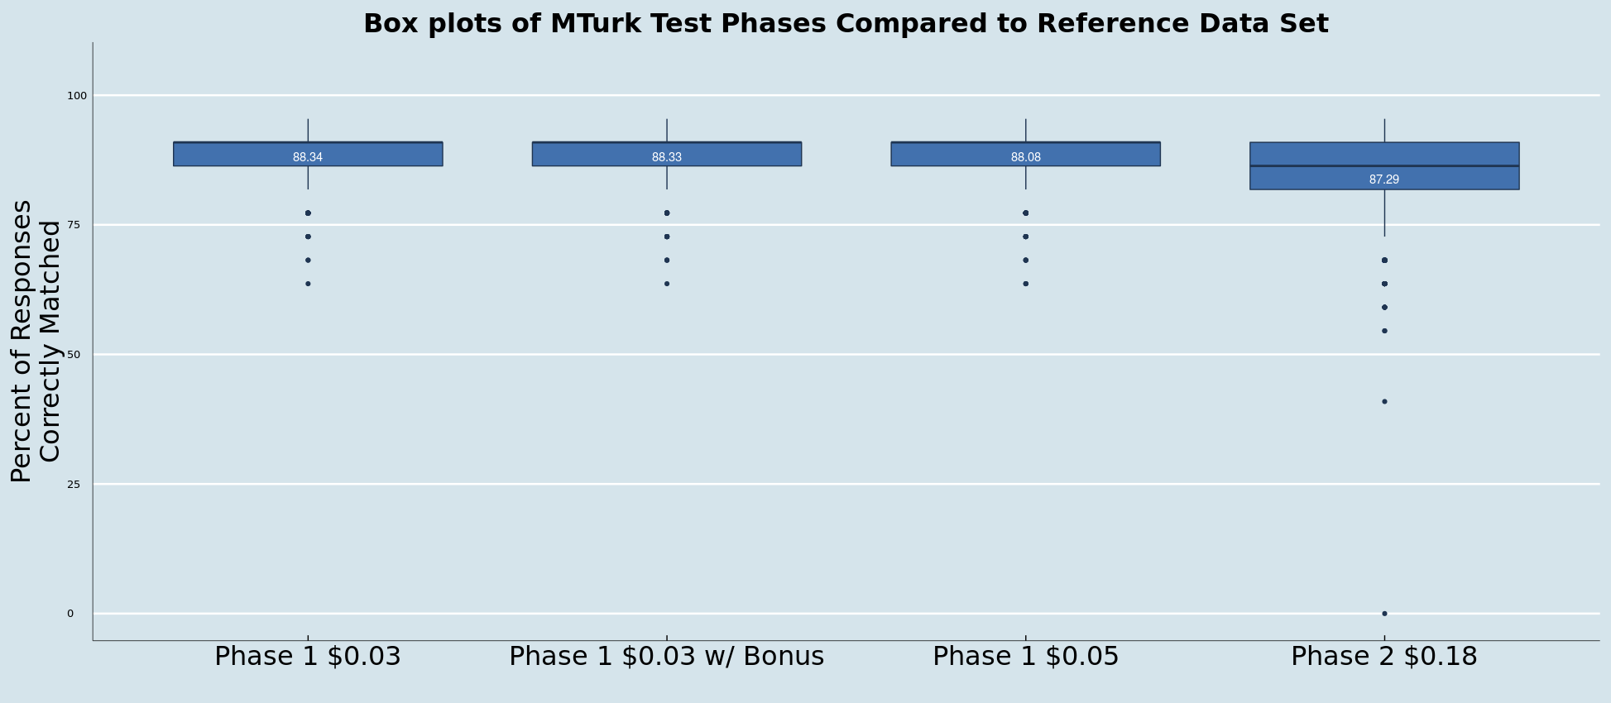
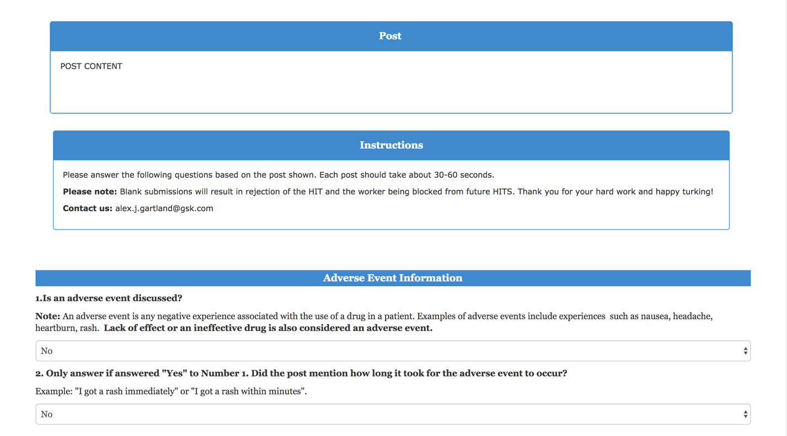
Leveraging Crowdsourcing to Help Classify Social Media Data for Medical and Patient Safety Insights
Alex Gartland¹, Jeffery L. Painter, JD², Tim A. Casperson³, Greg E. Powell, PharmD, MBA³
¹University of North Carolina at Chapel Hill, Chapel Hill, NC; ²JiveCast, Raleigh, NC, USA ; ³GlaxoSmithKline, Research Triangle Park, NC
Introduction
The classification and curation of social media data for use in drug safety is both time consuming and costly. This research aims to demonstrate how crowdsourcing can be used to accurately and efficiently classify social media data, potentially reducing associated cost, allowing trained drug safety experts to focus their time and expertise on assessing social media data.
Results
The results from Phase 1 yielded an overall percent accuracy with our reference dataset as follows: 92.8% for both the “$0.03 batch” and the “$0.03 batch with a bonus” bathes and 92.5% for the “$0.05 batch”. Curation time of each of the three Phase 1 batches was approximately 6 days. Phase 2 was curated in less than a day and a half and had an overall accuracy of 91.6%.
Phase 1 and 2 Summary Statistics
Background
Pharmacovigilance, or more commonly drug safety, is primarily focused on identifying and evaluating safety signals (unwanted or unexpected effects from taking a medicine). The gold standard data source in the field is currently spontaneously reported adverse events collected in the FDA Adverse Event Reporting System (FAERS¹). The major drawbacks with spontaneous data include under-reporting and lack of quality/generalizability. For the last few years, pharmacovigilance efforts have evolved by increasing the utilization of observational data (such as electronic medical health records and insurance claims), however limitations also exist. More recently, drug safety experts have begun to look at the use of social media as a timelier source of geographically diverse pharmacovigilance information².
 | Number of Posts | Number of Questions | Number Match | Percent Match | Curation Time(Hours)
Phase 1
$0.03 per Post | 500 | 11,000 | 10,217 | 92.8% | 147
$0.03 per Post with $1.00 bonus per 50 Posts | 500 | 11,000 | 10,216 | 92.8% | 147
$0.05 per Post | 500 | 11,000 | 10,189 | 92.6% | 146
Phase 2
$0.18 per Post | 5,000 | 110,000 | 100,981 | 91.8% | 33
Phase 2 Summary Statistics
Objective
This research evaluates whether crowdsourcing, via Amazon Mechanical Turk (MTurk) can be used as a platform to accurately and efficiently classify medically relevant concepts in social media posts.
Question Name | Number Match | Percent Match | Number of Posts
Adverse Event Post mentions
Proto-AE* | 4177 | 83.5 | 5000
Time to Onset | 4823 | 96.5 | 5000
Outcome | 4542 | 90.8 | 5000
Poster Information
Poster Type | 3481 | 69.6 | 5000
Post Mentions
Personally Identifiable Information | 4906 | 98.1 | 5000
Concomitant Medications | 4461 | 89.2 | 5000
Occupation | 4907 | 98.1 | 5000
Education | 4963 | 99.3 | 5000
Smoking | 4874 | 97.5 | 5000
Alcohol Use | 4973 | 99.5 | 5000
Illicit drug use | 4949 | 99.0 | 5000
Pregnancy | 4968 | 99.4 | 5000
Health Services Information | 4728 | 94.6 | 5000
Seeking Information | 4711 | 94.2 | 5000
Drug Abuse | 4891 | 97.8 | 5000
Product Complaint | 4694 | 93.9 | 5000
Medical History | 4800 | 96.0 | 5000
Product Information
Route | 4181 | 83.6 | 5000
Formulation | 3911 | 78.2 | 5000
Dosing | 4719 | 94.4 | 5000
Indication | 4031 | 80.6 | 5000
Benefit Discussed | 4291 | 85.8 | 5000
Total | 100,981 | 91.8 | 5000
Methods
A dataset consisting of ~15,000 social media posts was previously curated by GlaxoSmithKline drug safety scientists/physicians and served as the reference dataset for comparing crowdsourced classifications. Amazon Mechanical Turk (MTurk) was chosen to crowdsource basic classification of social media posts using the reference dataset. The goals were to measure cost, accuracy and time (Phase 1) and quality and time (Phase 2). Phase 1, consisting of three identical batches of 500 randomly selected posts, was tested at three variable price points -- $0.03, $0.03 with a $1.00 bonus per 50 posts, and $0.05. Each post was reviewed by three unique MTurk workers (Turkers) and compared to the reference dataset using a majority voting system. Phase 2 consisted of 5,000 randomly selected posts where each post was reviewed only once by Turkers and then compared to the reference dataset. To help ensure quality we implemented measures to detect poor quality (e.g. use of bots) and then applied an accept/reject system to posts completed by Turkers.
* Proto-AE – for the purposes of this study, we did not attempt to identify a true adverse event, but looked for the qualifications that would be typical of an AE and therefore, refer to all potential AE posts as Proto-AEs
Fig 1: Curation tool used by experts
Fig 3: Side by side box plots of accuracy in each test phase
Discussion
These results show that the average Turker can review and classify social media posts in preparation for a range of medical insights with over 90% accuracy as compared to a trained drug safety expert. Overall the cost of curation was relatively low ($0.03 to $0.18 per post) and the rate of review increased as the pay increased. At the $0.18/post pay rate Turkers would have been able to review the entire reference dataset (~15,000 posts) in about 12 days (the original review by internal staff took ~3 months to complete). Additional research is required to further assess the strengths and limitations of crowdsourcing for medical insights.
Fig 2: Mechanical Turk user interface
References and Acknowledgments
1. FDA, FDA Adverse Event Reporting System, 2016 (accessed Feb 8, 2016), http://www.fda.gov/Drugs/GuidanceComplianceRegulatoryInformation/Surveillance/AdverseDrugEffects/.
2. Gregory E. Powell, Harry A. Seifert, Tjark Reblin, Phil J. Burstein, James Blowers, J. Alan Menius, Jeffery L. Painter, Michele Thomas, Carrie E. Pierce et. al. Social Media Listening for Routine Post-Marketing Safety Surveillance. Drug Safety 2016. https://www.ncbi.nlm.nih.gov/pubmed/26798054
We also thank Arooj Akhtar and Richard Le for their work on this project including assisting with study design and data analysis
Conclusion
Crowdsourcing is a cost effective and efficient method for classifying basic medical information contained in social media posts.

