Slide 1
On the Perils and Pitfalls of PRR Analysis as Applied to Social Media Safety Surveillance
Jeffery L. Painter, Medical Advanced Analytics, GlaxoSmithKline

Slide 2
Outline
Motivation for our work
Brief History of Pharmacovigilance (PV)
Some Basic Definitions
Proportional Reporting Ratio (PRR) Analysis
What is it? How is it useful?
Underlying Assumptions – Danger!
Alternative Methods for the Automation of Social Media Listening for PV
Clustering
Outlier Detection

Slide 3
The Motivation for Social Media Listening for PV
Enabling early detection of potential risks pertaining to medication use
Listening to the voice of the patient
Patient
Health
Ecosphere
Medicine

Slide 4
Brief History of Pharmacovigilance (PV)
GSK/SAS pilot
FDA mandate
2011
Observational data
Big data
Thalidomide prescribed for treating nausea during pregnancy – resulted in thousands of birth defects
Electronic records
Linking data bases
Sentinel
OMOP
SafetyWorks
Insight Explorer
2014
1960’s
1970’s
1980’s
2000’s
2010’s
Notes:
Sentinent – FDA’s big data project for drug safety OMOP – Public partnership to build big data methods and algorithms

Slide 5
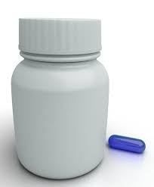
Basic Definitions
Adverse Event
An unwanted or unintended side effect resulting from taking a medication for its intended use, not necessarily harmful or serious
X

Slide 6
Basic Definitions
Pharmacovigilance (PV) has two pervasive definitions
Watchfulness in guarding against danger from products or providing for safety of the product
expansive beyond just regulations and frames the construct for use in academia and the sciences
The collection and scientific evaluation of adverse drug reactions (ADR) under normal conditions of use for regulatory purpose
Restricts the concept to regulatory compliance only
Adverse Event (AE) Case
Four criteria for a reportable event include (1) a patient, (2) a reporter, (3) a suspect drug and (4) an adverse event
Social Media Listening
We have taken a stance of first de-identifying the poster / patient prior to analysis of any social media data through a third party data provider
Social media data typically does not meet the standard of an AE case and is therefore not used in our regulatory reporting systems
Sources only include publicly available posts from various social media sites including Twitter, Reddit and patient centric forums (e.g. the American Arthritis Foundation administered by Inspire)

Slide 7
Basic Definitions
PRR
Proportional Reporting Ratio
Simple formula, easy to calculate
Requires several assumptions
Signal Detection
PRR and other proportional methods (Risk Ratio, Odds Ratio, etc.) are all concerned with "signal detection" - often used as a synonym to signal of disproportionate reporting (SDR)
Technically, the identification of a true signal involves a more thorough evaluation requiring:
clinical plausibility AND
a pharmacologic method of action
as compared to a simple statistical measurement used to identify an SDR

Slide 8
The Problem with PRR and Social Media Listening
Manual Evaluation of Social Media does not scale
Proportional Reporting Ratio
Simple formula, easy to calculate
Widely used in routine safety monitoring with observational data
Easy to interpret
However, it requires several underlying assumptions about the data
When applied to observational data, we have the comfort of knowing that at medical professionals entered the data into the system
Electronic health records / electronic medical records
Insurance claims
Standardized coding schemes typically applied
ICD-10
MedDRA
SNOMED, etc
Spontaneous reporting systems (e.g. AERS, VigiBase) typically reported by a medical professional before inclusion
Social media is a free for all!

Slide 9
Why do we care? Who is posting health information online?
85% of U.S. adults use the internet
95% of U.S. teens use the internet, so post volume will likely increase with time
6% of adult internet users, or 4% of all adults, have posted comments, questions or information about health or medical issues on a website of any kind, such as a health site or news site that allows comments and discussion.
3-4% of adult internet users have posted their experience with health care service providers or treatments in the previous 12 months
These survey results estimate 6 million US adults post their experiences with drugs or providers each year
Source:
Fox S, Duggan M. Health Online 2013. Pew Internet and American Life Project. 2013. Available at: http://pewinternet.org/Reports/2013/Health-online.aspx

Slide 10
Signal Detection
Real World Example – Panadol Syringes in Australia Posted on Facebook

Slide 11
Signal Detection
Safety Alert and Recall Initiated

Slide 12
The Problem with PRR and Social Media Listening
Manual Evaluation of Social Media does not scale
100 social media
documents
1 Million
social media
documents

Slide 13
Results of Automated Classification of Adverse Events
Discrepancies between Machine Learning methods and Medical Expert Reviews
Applied Basket of Words Method plus Naïve Bayesian Classifier
Data Source | Posts Reviewed | Tagged Proto-AE | Tagged Mention | Bayes Proto-AE % | Actual Proto-AE | Actual Proto-AE %
twitter | 10,560 | 4,732 | 5,828 | 44.81% | 2,528 | 25.18%
facebook | 6,940 | 3,470 | 3,470 | 50.00% | 2,018 | 30.43%
Total | 17,500 | 8,202 | 9,298 | 46.87% | 4,546 | 25.98%
There is a significant increase (55%) in the reported number of proto-AEs identified through machine learning methods versus what the medical experts agreed upon
Note:
Actual Proto-AE numbers reflect results after removal of posts consisting of spam and final review by medically trained safety scientists
A Proto-AE is the term designated for a proto-typical AE as defined by the training set used to build the text classifier for identification of an ADR in social media
*Results of preliminary pilot on the monitoring of adverse events in social media from 2014 conducted by GlaxoSmithKline in collaboration with Epidemico

Slide 14
If not PRR, then what?
Problems in automatic classification of the data
Language issues
Slang
Misuse of terms / misidentification of product
A single product has different names in various countries
Local taboos in disclosing information
PRR is based on the assumption that we have the both the correct mention of:
The drug AND
The adverse event
Misclassification of either will result in bias of the underlying analysis
Text clustering offers an alternative to help identify when something unusual is happening
Most of the time, people who mention drugs online are not talking about adverse events

Slide 15
Clustering social media reports
Social Media Posts

Slide 16
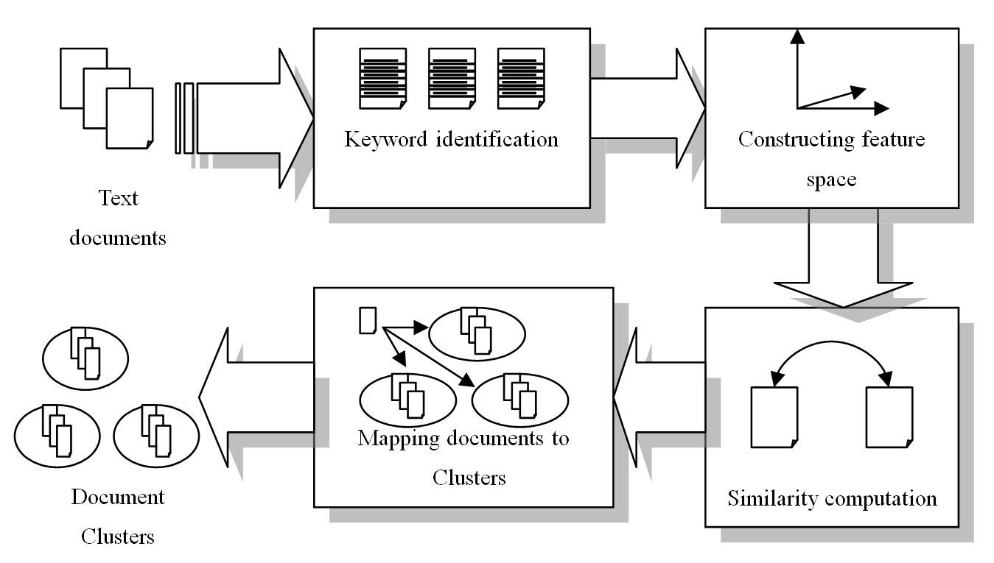
Text Clustering Process

Slide 17
Understanding Trends in Social Media Reports
Keywords
Each cluster or topic will have a set of “keywords” which the documents were clustered around
Cluster Centers
Documents closest to the center of the cluster are most representative of the topic of the cluster

Slide 18
Cluster Centers
Cluster Centers

Slide 19
Outliers
Clustering helps us understand the most prevalent topics in a set of documents
Can also be interesting to identify what documents do not follow those popular topics
“What are the most unique statements made”
Outliers are simply documents farthest away from center of cluster

Slide 20
Outliers
Outliers

Slide 21
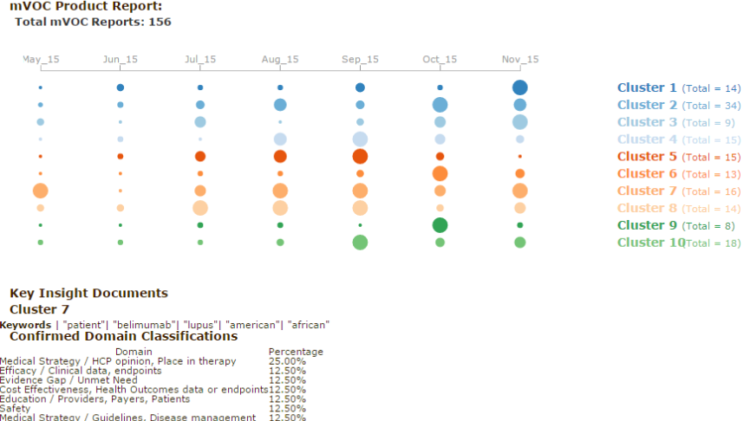
Alternatives to PRR through Trend Analysis

Slide 22
Thank you !

