Slide 1
Application of Classification and Clustering Methods on mVoC (Medical Voice of Customer) data for Scientific Engagement
Yingzi Xu, Department of Statistics, North Carolina State University
Jeffery Painter, Medical Advanced Analytics, GlaxoSmithKline

Slide 2
Outline
Medical Voice of Customer (mVoC)
Goal
Solution: Medical Insight Explorer
Machine learning Algorithm behind Medical Insight Explorer
Classification
Clustering

Slide 3
Outline
Medical Voice of Customer (mVoC)
Goal
Solution: Medical Insight Explorer
Machine learning Algorithm behind Medical Insight Explorer
Classification
Clustering

Slide 4
What is Medical Voice of the Customer (mVOC) ?
Feedback on the medicines collected from various customer groups including patients, payers, providers, and policy makers in the health care environment.
Customer medical priorities, goals, research plans and/or initiatives..
Non-GSK scientific activities.
Customer impressions or feedback on medical unmet needs, treatment guidelines/pathways, or burden of disease.
Customer data needs or evidence gaps.
Customer feedback on GSK products, studies or services.
Customer impressions of /reactions to health care trends, health care or other health policy issues.
Investigator feedback and suggestions.
Customer approaches to managing patients or populations effectively

Slide 5
Outline
Medical Voice of Customer (mVoC)
Goal
Solution: Medical Insight Explorer
Machine learning Algorithm behind Medical Insight Explorer
Classification
Clustering

Slide 6
Ultimate Goal
Patient
Overall Health
Atmosphere
Medicine

Slide 7
Manual State is Not Scalable for Growing Information
70 mVOC
documents
70000 mVOC
documents

Slide 8
Outline
Medical Voice of Customer (mVoC)
Goal
Solution: Medical Insight Explorer
Machine learning Algorithm behind Medical Insight Explorer
Classification
Clustering

Slide 9
Medical Insight Explorer
Java web application
MySQL database
Primary tasks
Classification
Classify the mVoC entries into various domains, e.g. efficacy, safety, price concerns
Clustering
Under each domain, employ cluster analysis to determine topics and trends over time

Slide 10
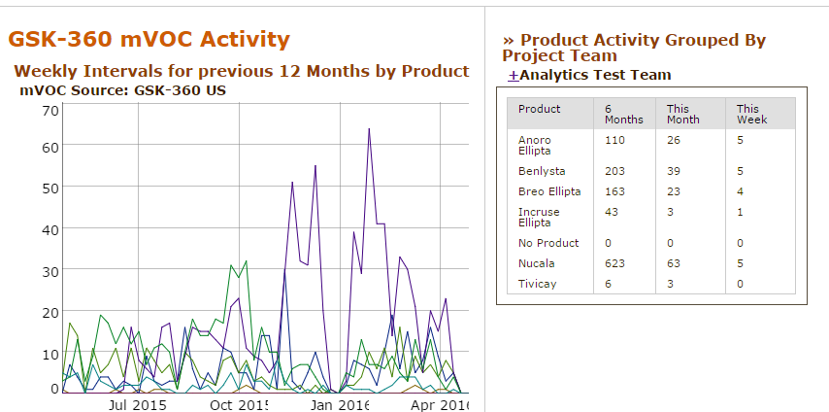
Medical Insight Explorer

Slide 11
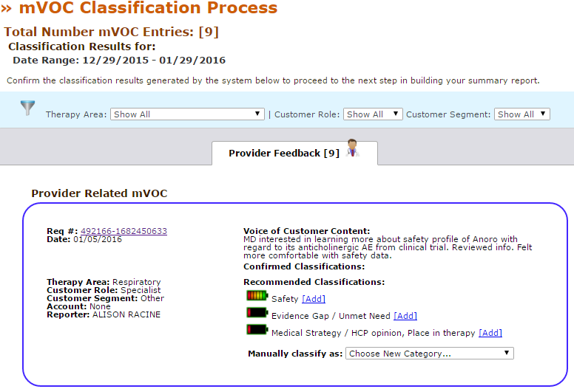
Medical Insight Explorer - Classification

Slide 12
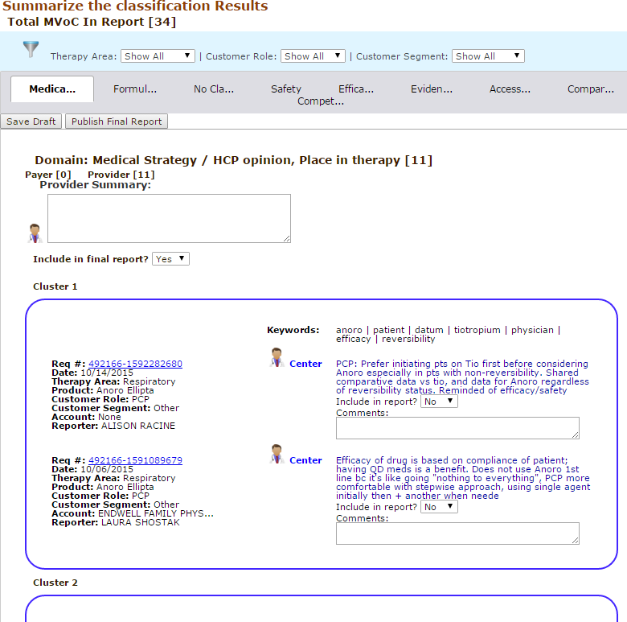
Medical Insight Explorer - Clustering

Slide 13
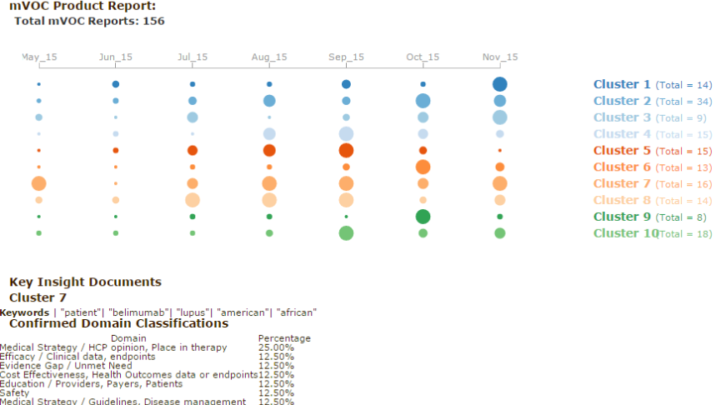
Medical Insight Explorer – Trend Analysis

Slide 14
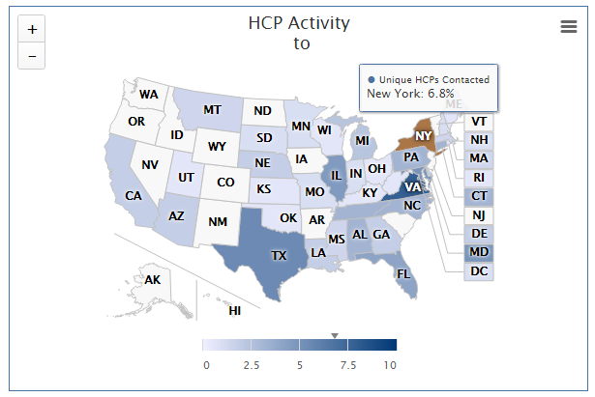
Medical Insight Explorer – Activity Map

Slide 15
Outline
Medical Voice of Customer (mVoC)
Goal
Solution: Medical Insight Explorer
Machine learning Algorithm behind Medical Insight Explorer
Natural Language Processing
Document Representation
Classification
Clustering

Slide 16
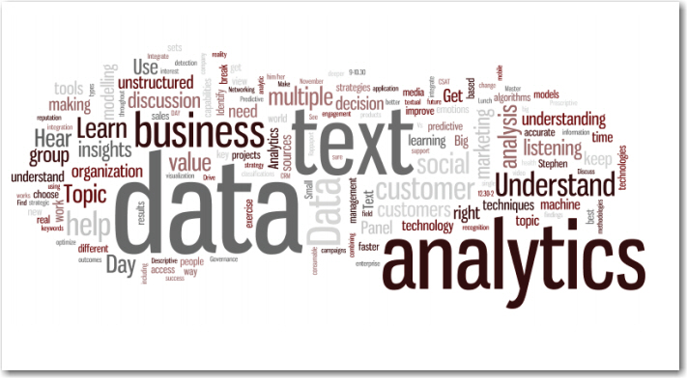
It’s all about text mining !

Slide 17
Natural Language Processing
Tokenize into words
Text normalization
e.g. lowercase all words
Remove stopwords, punctuation
e.g. “the”, “and”, “of”, etc
Apply mVOC thesaurus to handle synonymous concepts
Built upon the WordNet ontology to get synonym sets
All the words in synonym sets will transform to the most frequently used term
e.g. “actuate”, “motivate”, “move”, “prompt”, “spark” → “activate”
Apply medical abbreviation dictionary to expand medical abbreviation to full terms
Based on several sources for commonly abbreviated terms used by health care professionals
Stemming
e.g. remove plurals, normalize verb tenses, reduce words to the root forms

Slide 18
Document Representation
Bag of words model
Each document can be represented as a vector of word counts regardless of the word order or grammar
Document - term matrix consists of
Term frequency (tf)
Term frequency – Inverse document frequency (tf-idf)

Slide 19
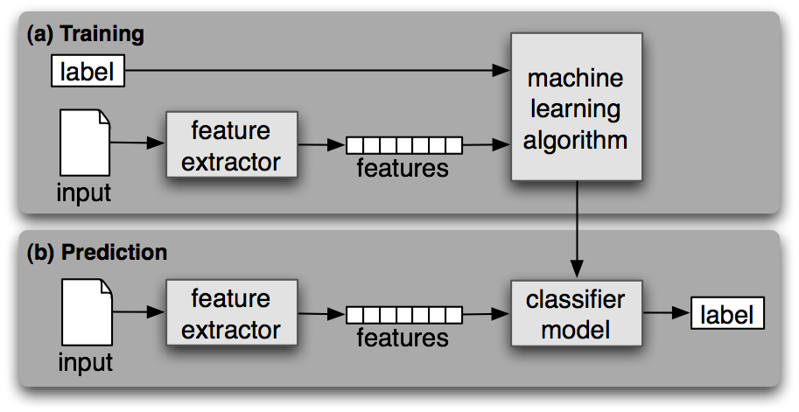
Text Classification Process

Slide 20
Text Classification Algorithm
Naive Bayes (NB)
Support Vector Machine (SVM)
K- Nearest Neighbors (KNN)

Slide 21
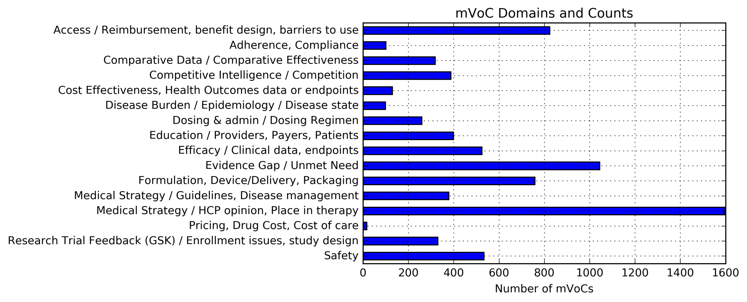
Text Classification Experiment Data
Time period from 01/01/2014 to 02/29/2016
Keep only 16 domains we are interested in
7695 documents

Slide 22
Text Classification Experiment Result
We choose Multinomial Naïve Bayes as the classification method in our Medical Insight Explorer.

Slide 23
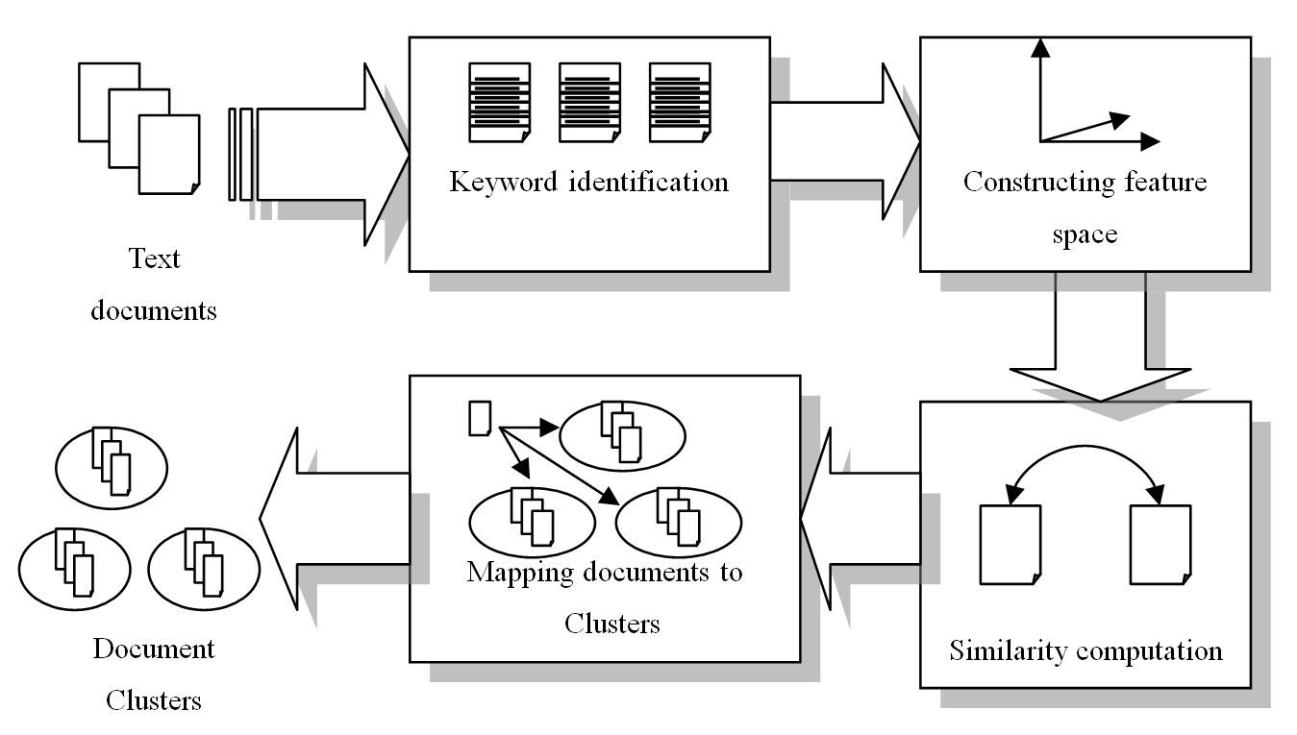
Text Clustering Process

Slide 24
Text Clustering Algorithm
Traditional Methods
K-Means
Hierarchical Clustering
Methods utilizing Topics
Latent Semantic Analysis (LSA)
Non-negative Matrix Factorization (NMF)
Latent Dirichlet Allocation (LDA)

Slide 25
Text Clustering Experiment Data

Slide 26
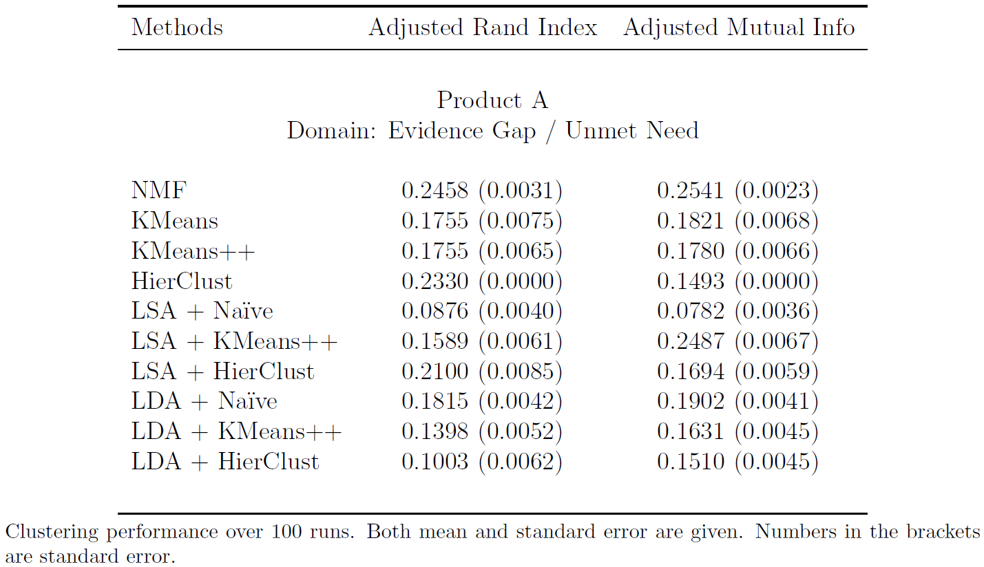
Text Clustering Experiment Result

Slide 27
Text Clustering Experiment Result

Slide 28
Text Clustering Experiment Result
Non-negative Matrix Factorization (NMF) almost uniformly performs the best
We choose NMF as our clustering method

Slide 29
What will we achieve?
Enable non-technical experts to gain deeper understanding of our medicines and customers
Better inform the team so that they could develop timely and appropriate strategies
Ultimately improve the care of the patients

Slide 30
Thank you !

